Slide 1

The verbs tener (to have) and
venir (to come) are among the most frequently used in Spanish. Because most of their
forms are irregular, you will have to learn
each one individually.
©2014 by Vista Higher Learning, Inc. All rights reserved.
3.4-<number>

Slide 2
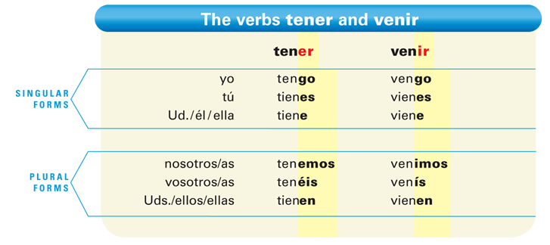
©2014 by Vista Higher Learning, Inc. All rights reserved.
3.4-<number>

Slide 3
The endings are the same as those of regular -er and -ir verbs, except for the yo forms, which are irregular: tengo, vengo.
©2014 by Vista Higher Learning, Inc. All rights reserved.
3.4-<number>

Slide 4
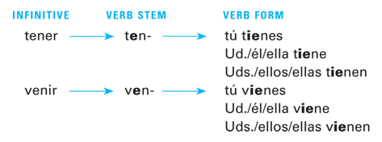
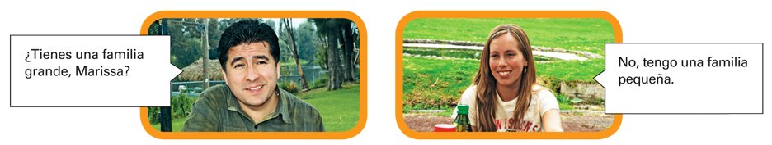
In the tú, Ud., and Uds. forms, the e of the stem changes to ie, as shown below.
©2014 by Vista Higher Learning, Inc. All rights reserved.
3.4-<number>

Slide 5
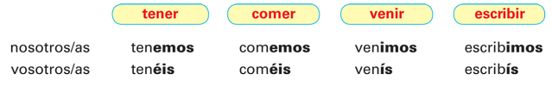
Only the nosotros and vosotros forms are regular.
©2014 by Vista Higher Learning, Inc. All rights reserved.
3.4-<number>

Slide 6
In certain idiomatic or set expressions in
Spanish, you use the construction tener + [noun] to express to be + [adjective]. This chart contains a list of the most common expressions with tener.
©2014 by Vista Higher Learning, Inc. All rights reserved.
3.4-<number>

Slide 7
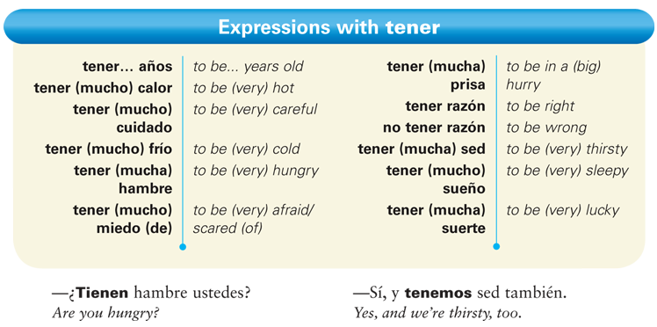
©2014 by Vista Higher Learning, Inc. All rights reserved.
3.4-<number>

Slide 8
To express an obligation, use tener que
(to have to) + [infinitive].
©2014 by Vista Higher Learning, Inc. All rights reserved.
3.4-<number>

Slide 9

To ask people if they feel like doing something, use tener ganas de (to feel like) + [infinitive].
©2014 by Vista Higher Learning, Inc. All rights reserved.
3.4-<number>

Slide 10

Provide the appropriate forms of tener and venir. The first item in each column has been done for you.
Ellos ________ dos hermanos. Yo _____ una hermana. El artista _____ tres primos. Nosotros _____ diez tíos. Eva y Diana _____ un sobrino. Usted _____ cinco nietos. Tú _____ dos hermanastras. Ustedes _____ cuatro hijos. Ella _____ una hija. | Mis padres ________ de México. Tú _____ de España. Nosotras _____ de Cuba. Pepe _____ de Italia. Yo _____ de Francia. Ustedes _____ del Canadá. Alfonso y yo _____ de Portugal. Ellos _____ de Alemania. Usted _____ de Venezuela.
tener
venir
tienen
vienen
©2014 by Vista Higher Learning, Inc. All rights reserved.
3.4-<number>

